Slide 1


AUTOMOTIVE CYBER SECURITY ON “ZERO TRUST”
TEAM MEMBERS
Naveen Bondhu
Pavan Kumar Pula
Pavithra Vonteddu
Sree Laya Karray
Anudeeep Banala

Slide 2

Introduction
In this presentation we will discuss about the “ZERO TRUST” it is also called as zero trust architecture in the automotive sector.
And we opted two central domains :
Identity and access management (IAM)
Risk management (RM)
This domains play crucial role in the automotive sector to implement zero trust model that’s the reason behind choosing those particular domains.
We discuss about how identity and access management plays key role in securing safety and functionality of autonomous and interlinked vehicles by making sure that only approved devices have access to their systems.

Slide 3
We will also explore the importance of security and risk management, particularly in the age of connected and driverless automobiles, in identifying any threats to the vehicle and its data.
We will explore our discussion on the maxim "never trust, always verify," which is from the foundation of john kindervag's 2010 introduction of the “zero trust” concept.
We will discuss how this project fits with our professional aspirations and areas of interest in research, especially cybersecurity.
Lastly, we will talk about the particular cybersecurity challenges in the automotive industry that zero trust seeks to resolve, as well as how IAM, security, and risk management deal with these concerns.

Slide 4

MOTIVATION
For a number of reasons, the two domains of identity and access management (IAM) and security and risk management are essential to the automobile industry's adoption of the “zero trust” concept.
Identity and access management (IAM):
Constant verification: the "never trust, always verify" concept underpins the “zero trust” approach. This means that constant authentication and authorization a crucial IAM function must be applied to every device seeking to access the vehicle's systems.
Preventing unauthorized entry: as cars are increasingly networked, there are additional entry points, which raises their susceptibility to cyberattacks. IAM lowers the risk of unknow permission and data breaches or cyberattacks by make sure that only admin devices can access a vehicle's systems.

Slide 5

RISK MANAGEMENT:
Proactive threat detection: as connected and autonomous cars become more common, so do the hazards and weaknesses. Preventive threat identification and mitigation are key components of security and risk management.
Risk control: by making sure that each request is thoroughly verified, and that no implicit confidence is given, the “zero” confidence model's implementation can help reduce these risks. This is consistent with the fundamental roles of risk management and security.

Slide 6

DOMAINS
Explanation of two domains
Identity Access Management
Risk Management
Risk management: the tasks of security and risk management include spotting possible threats and weak points and putting preventative measures in place.
Regarding automotive cybersecurity with the growing number of connected and autonomous automobiles, this domain is essential for identifying potential threats to the vehicle and its data.

Slide 7
Identity And Access Management:
A corporate network's IT resources can only be accessed by authorized entities (people, systems, and devices) thanks to the infrastructure as a service (IAM) framework of policies and technologies. Regarding automotive cybersecurity
IAM makes ensures that the systems of a car are only accessible by authorized devices or the systems. In the age of autonomous and connected vehicles.
which are more frequently the targets of cyberattacks, this is vital.
Every device trying to access the car's systems has to go through continuous authentication and authorization as part of the “zero trust” concept. This follows the adage "never trust, always verify.”
IAM can guard against unwanted access to the car's systems, preserving both its security and functionality.

Slide 8

“ZERO” TRUST
By using zero trust, these dangers can be reduced and the vehicle's security is increased. This is accomplished by making sure that each request is thoroughly cross - checked and that no implicit confidence is given.
The goal of security and risk management is to proactively detect and resolve possible security vulnerabilities before they become exploitable.

Slide 9

INDUSTRY FOCUS
The core reason to choose automotive sector is because the growing number of automotive vehicles in every country was significantly increasing day after day.
As a result access to this automotive vehicles is getting very easy so by focusing on this field with help of identity and access management we can secure the and provide authentication moreover multifactor authorization in every time will provide more security to avoid access to unknow or unauthorized person to get in to slove this issue we opted to focus on this automotive sector.

Slide 10
Questions
How can Zero Trust principles, as outlined in Deloitte's analysis, be applied to enhance access control systems in connected vehicles to prevent unauthorized access?
According to Levine & Tucker’s discussion on Zero Trust Architecture, what are the recommended methods to detect and respond to unauthorized access attempts in automotive systems?

Slide 11

How can zero trust principles, as outlined in deloitte's analysis, be applied to enhance access control systems in connected vehicles to prevent unauthorized access?
From the article of Deloitte states that the Zero Trust model is also crucial in improving access controls in the industry of automotive sector. Zero Trust is guided by the framework that no person or machine should be inherent to trust where the risk for each person or machine poses must be assessed and authenticated at all the given points where digitalization is in use. Deloitte notes that this model is critical in an environment such as the industry as an upsurge in connected cars poses new threats. With Zero Trust in place, the access is authenticated, authorized, and continuously validated for each request. As a result, only genuine users and machines can access the vehicle systems. This strategy reduces unauthorized access significantly(Deloitte, 2023).

Slide 12

2. According to levine & tucker’s discussion on zero trust architecture, what are the recommended methods to detect and respond to unauthorized access attempts in automotive systems?
In the article, Levine and Tucker describe the various methods belonging to the Zero Trust architecture that can be used to identify and respond to unauthorized attempts in automotive systems. The focus is on creating a few levels of “dynamic heights” which reflect security measures depending on the current risk and trustworthiness assessments. The most efficient methods are those forcing the system into constantly monitoring the behavior of all users with the aid of behavior analytics, using access controls that may completely restrict many users based on their need to access information, or threat intelligence that can help to anticipate and eliminate the possible threats. This way, the approach becomes proactive, checking the condition of security of all devices and users irrespective of the circumstances and, as a result, improving the security status of the automotive systems. (Levine & Tucker, 2023).

Slide 13

IAM IMPORTANCE
Key Market Insights
Overall identity and access management market capitalization was worth up to 13.41 billion in 2021 by the 2028 it will raise up to 34.52 billion in couple of years.
By the analysis we can see the significant growth in 9.1% in 2020 compared to the average year from 2017 to 2019.
The interest towards IAM was gaining lot of attention due to the security issues which impacts the whole sector to take control over need to implement identity and access management.

Slide 14
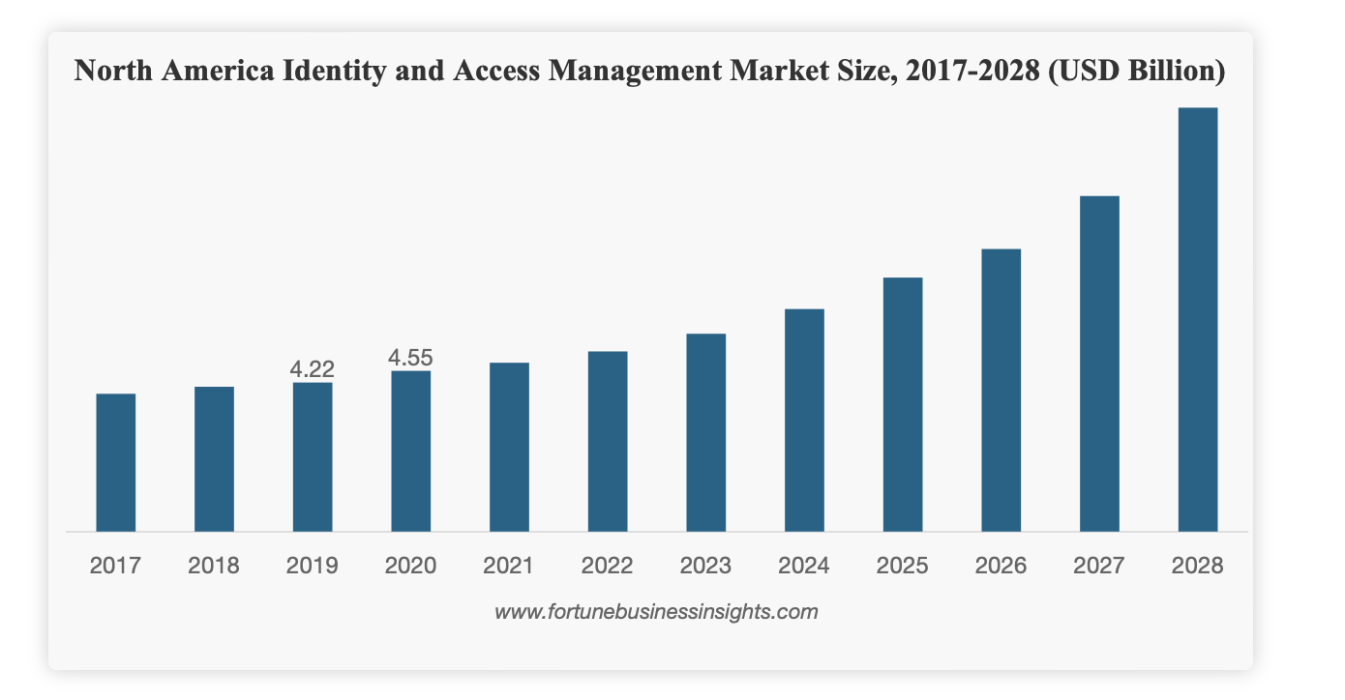
Iam growth 2017- 2024

Slide 15

ZERO TRUST IN AUTOMOTIVE SECTOR
A security paradigm known as "zero trust" in the automotive sector holds that no entity, whether within or external to the network, can be implicitly trusted. Only after thorough identity verification and continuing monitoring of people, objects, and actions is access granted. This tactic aims to increase threat detection and decrease potential attack surfaces in order to enhance cybersecurity.

Slide 16
Associated research articles and our acquisitions (Advancing automotive cybersecurity through zero trust architecture, n.D.)
Challenge: traditional security models in connected cars often grant excessive trust, leaving them vulnerable to cyberattacks.
Identity and access management (iam): zero trust strengthens iam by:
Continuously verifying user and device identities.
Granting least privilege access based on the context of each request.
Encryption: data is encrypted at rest and in transit, minimizing the impact of unauthorized access.

Slide 17
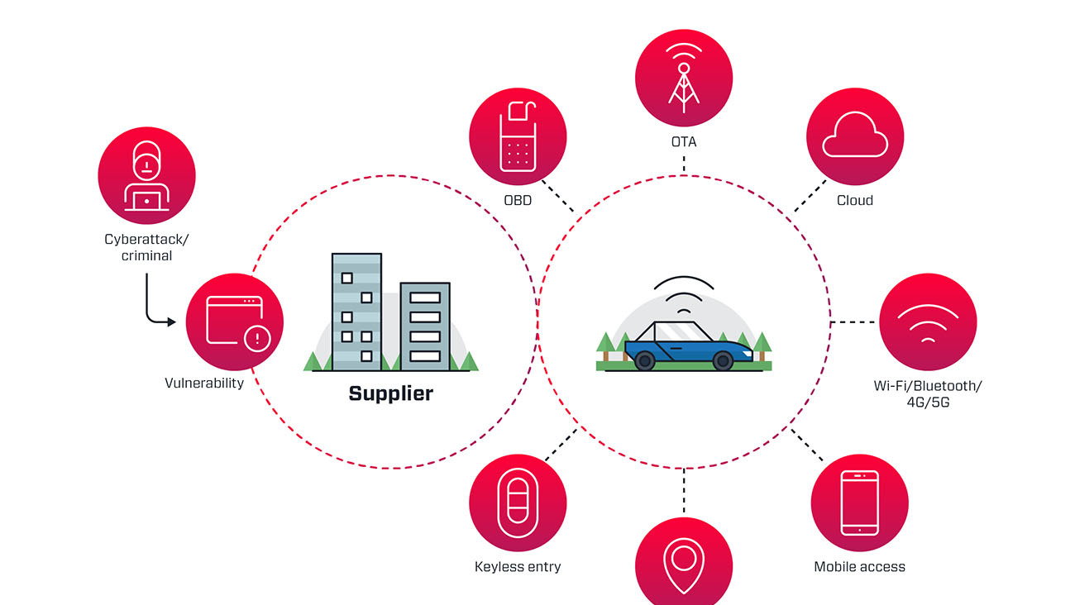
https://documents.vicone.com/images/automotive_attack_surfacepiDVTMX.jpg
This diagram illustrates the potential attack points on a connected car and the associated cybersecurity risks.

Slide 18

Modern cars become increasingly connected and the features like remote controls, real-time traffic updates, entertainment within cars, etc. Are increased. This interlinkage offers convenience, but it comes with new cybersecurity risks.
Potential attack points
Hackers can target various aspects of a connected car, including:
Cloud services
Mobile apps for remote access
Keyless entry systems
GPS navigation systems
On-board diagnostics (OBD) port
Communication technologies (wi-fi, bluetooth, 4G, 5G)

Slide 19
BENEFITS
Enhanced threat detection and response
Reduced attack surface
Improved data security and compliance (ISO/SAE 21434, UN R155)
Increased resiliency against attacks and failures
Strengthened trust and collaboration within the automotive ecosystem

Slide 20

CONCLUSION
The "Zero Trust" strategy is essential to transforming cybersecurity in cars. We address significant vulnerabilities in connected automobiles by concentrating on Identity and Access Management (IAM) and Risk Management (RM). Zero Trust minimizes the attack surface and improves IAM through least privilege access, proactive threat detection, and continuous verification. This proactive strategy ensures a safer and more resilient future for connected vehicles by improving security while also fostering trust and collaboration throughout the automotive ecosystem.

Slide 21

Direct Quotes from Readings
“As the world pushes more into a future of autonomous vehicles, manufacturers will be required to put more time, effort, and money into the security of their platforms”(j. Anderson,2023, para 2).
“By adopting zero trust principles, automotive industry stakeholders can not only stay ahead of evolving cyber threats but also establish a robust security foundation that mitigates cyber risks and ensures the protection of critical assets”(vicone,2024, para 4).
“As vehicles become more connected, they become vulnerable to cyber threats that can have serious consequences for both individuals and society as a whole”(stefan, 2023, para 1).

Slide 22

References
J. Anderson, Q. Huang, L. Cheng and H. Hu, "A zero-trust architecture for connected and autonomous vehicles," in IEEE internet computing, vol. 27, no. 5, pp. 7-14, sept.-Oct. 2023, doi: 10.1109/mic.2023.3304893.
Keywords: {computer architecture;zero trust;security;engines;autonomous vehicles;vehicle dynamics;standards;connected vehicles;public transportation},
Advancing automotive cybersecurity through zero trust architecture. (n.d.). VicOne. https://vicone.com/blog/advancing-automotive-cybersecurity-through-zero-trust-architecture
Stefan. (2023, October 24). Security in automotive: connected cars, cyber risks, and Safeguarding the future of mobility - Stefanini. Stefanini. https://stefanini.com/en/insights/articles/security-in-automotive-industry

Slide 23

References
National highway traffic safety administration. (2020). Cybersecurity best practices for the safety of modern vehicles. Https://www.Nhtsa.Gov/sites/nhtsa.Gov/files/documents/vehicle_cybersecurity_best_practices_01072021.Pdf
Zero-trust in the age of software-defined vehicles. (N.D.). Deloitte united states. Https://www2.Deloitte.Com/us/en/pages/consumer-business/articles/zero-trust-cybersecurity-in-automotive-industry.Html
Kindervag, J. (2010). Build security into your network’s DNA: the zero trust network architecture. Forrester research.

Slide 24

ANY SUGGESTIONS?
You can email to
NaveenBondhu@my.unt.edu. So, I can discuss with my teammates.

Slide 25

THANK YOU

